Slide 1
INTERNET PROGRAMMING & MOBILE PROGRAMMING
System Modelling
UML DIAGRAMS
and Design
Context Diagram
Data Flow Diagram
Crowdsensed Drive Test Mobile Application
for Coverage Prediction
Class Diagram
Sequence Diagram
Task 4 • Group 10
Use Case Diagram
Deployment Diagram
1

Slide 2
Introduction & Purpose
Purpose of System Modelling
Diagrams Overview
Provide a clear blueprint before coding begins
Visualize the structure and behavior of the system
Describe interactions between users and components
Explain data movement within the application
Support software implementation and testing
Reduce design complexity
Improve stakeholder communication
Diagram | Purpose
Context Diagram | Overall interaction between external users and the system
Data Flow Diagram | How signal data moves through the application
Use Case Diagram | Functions performed by users and administrators
Sequence Diagram | Order of interactions between system components
Class Diagram | Structure of classes, attributes, and relationships
Deployment Diagram | Physical deployment of system components
2

Slide 3
Data Flow Diagram — Overview
The Data Flow Diagram (DFD) explains how signal measurement data moves through the system — from collection to coverage prediction and report generation.
0
Context Diagram
1
Main Processes
2
Signal Collection Detail
Presents the entire system as one process. Shows general interaction between the two external entities: Mobile User and Admin/Analyst.
Breaks the system into 5 major processes: Collect Data, Store Locally, Synchronize, Process & Analyze, Generate Reports.
Drills into 'Collect Signal Data': GPS retrieval, network scanning, signal measurement, metadata capture, validation, and local storage.
3
3

Slide 4
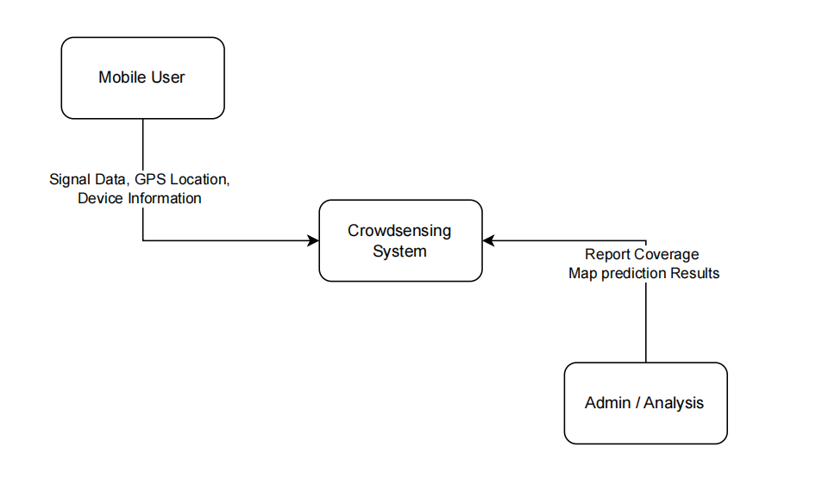
Context Diagram — Level 0 DFD
The entire application is represented as a single process interacting with Mobile User and Admin/Analyst.
4
4

Slide 5
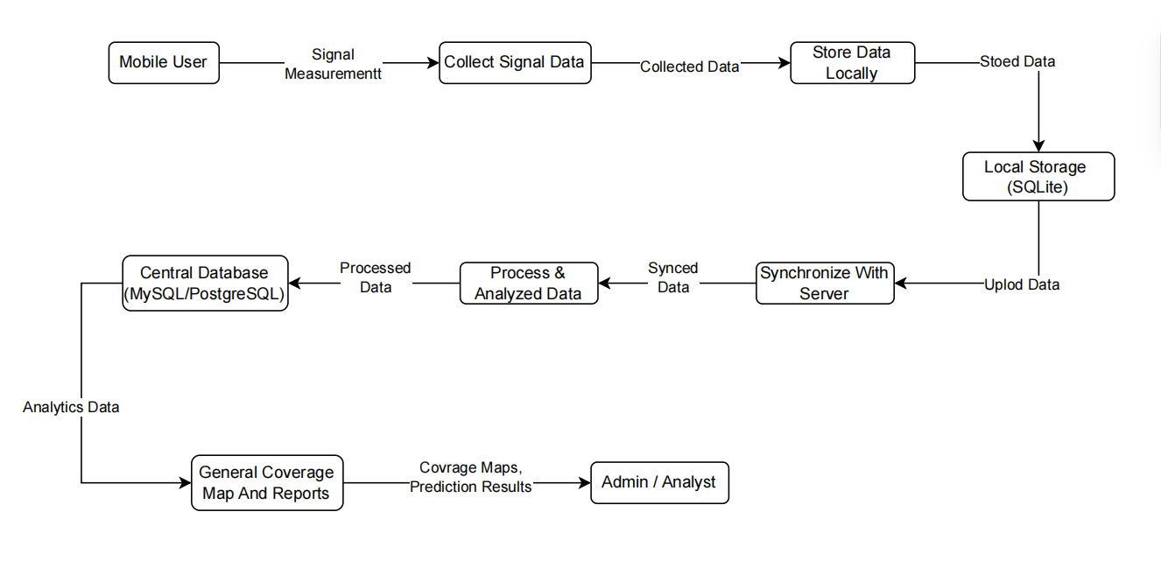
Level 1 Data Flow Diagram
5 Core Processes
1
Collect Signal Data
RSSI, RSRP, RSRQ, SINR, GPS, Cell ID
2
Store Data Locally
SQLite — offline-first, prevents data loss
3
Synchronize with Server
Upload, validate, deduplicate records
4
Process & Analyze
Cleaning, stats, coverage prediction
5
Generate Reports
Coverage maps, charts, analytics
5
5

Slide 6
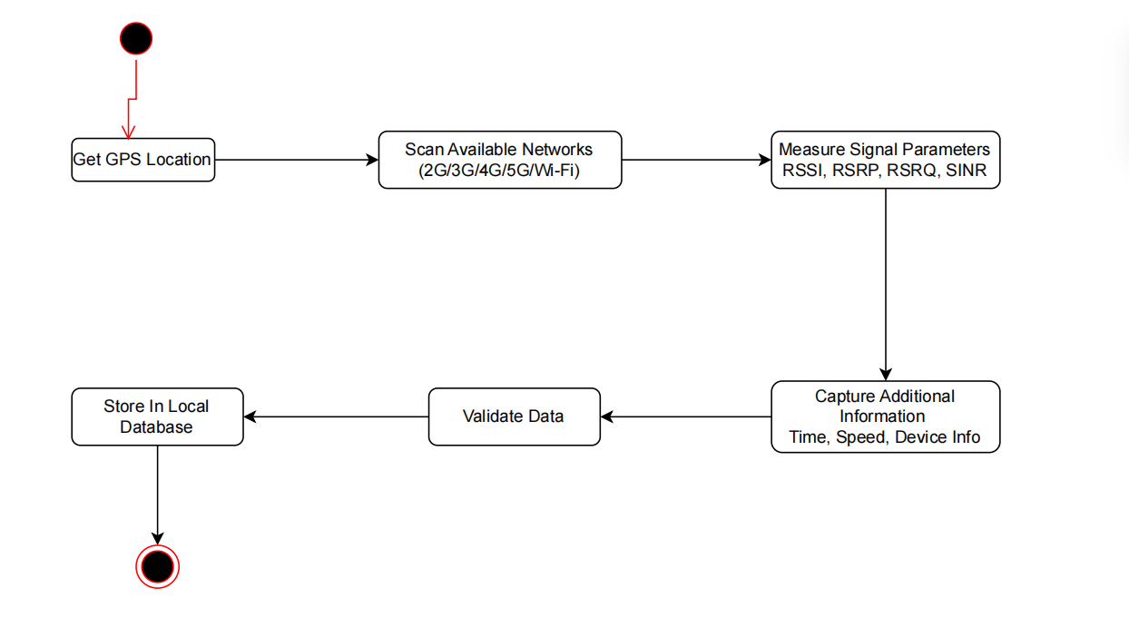
Level 2 DFD — Signal Data Collection Detail
Step Breakdown
1
Get Current GPS Location
(Lat, Lng, Speed, Time)
2
Scan Available Networks
(2G/3G/4G/5G/Wi-Fi)
3
Measure Signal Parameters
(RSSI, RSRP, RSRQ, SINR)
4
Capture Additional Info
(Device type, OS, Timestamp)
5
Validate Data
(Completeness, GPS validity, Duplicates)
6
Store in Local DB
6
6

Slide 7
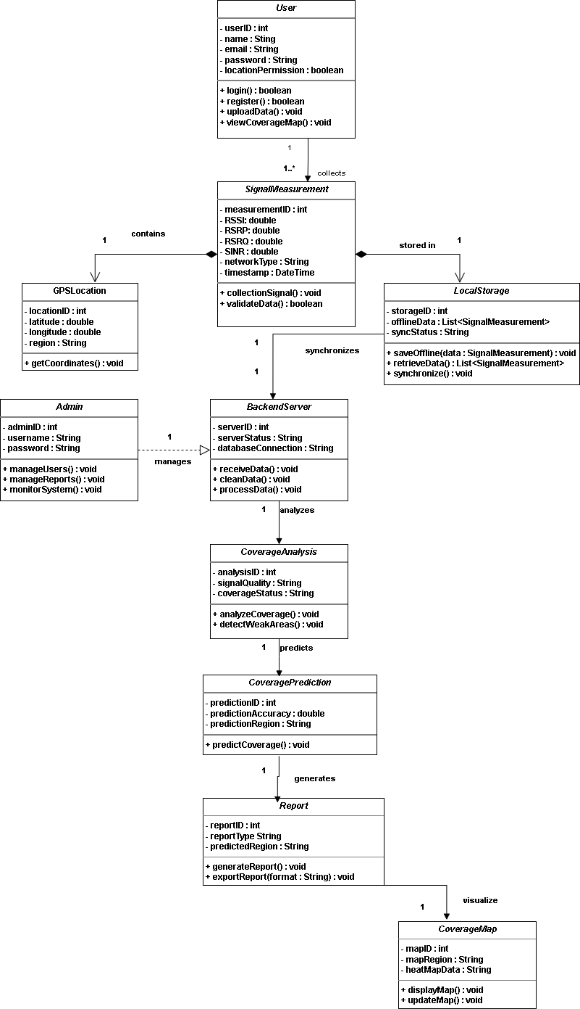
Class Diagram
Key Classes
User
Registers, logs in, uploads measurements, views maps
SignalMeasurement
Core data: RSSI, RSRP, RSRQ, SINR, network type, timestamp
GPSLocation
Latitude, longitude, region per measurement
LocalStorage
Offline SQLite cache with sync status management
BackendServer
Receives, validates, cleans, and processes data
CoverageAnalysis
Analyzes signal quality, detects weak zones
CoveragePrediction
Predicts coverage across geographic areas
Report
Generates summaries and exports
CoverageMap
Displays heat maps and signal overlays
Admin
Manages users, reports, backend operations
7
7

Slide 8
Sequence Diagram — Overview
The Sequence Diagrams show the order of interactions between system components during key operations. Four diagrams cover the full application lifecycle.
SD1
Background Signal Data Collection
SD2
Offline Storage & Synchronization
OS Timer triggers Background Service every N seconds. Service calls Telephony API for RSSI/RSRP/RSRQ/SINR and Location API for GPS. Bundles measurement and saves to Local DB.
When offline: measurements stored locally. When connectivity restored: batched HTTPS POST to Backend Server for validation and sync marking.
→ Slide 9
→ Slide 10
SD4
Coverage Analysis & Map Visualization
SD5
Notifications & Alerts
User opens map view → Backend API queries DB → Analytics Engine interpolates and classifies → heatmap rendered on device.
After sync, Alert Engine checks RSSI thresholds. Creates zone alerts and sends push notifications. Sync failures trigger retry with exponential backoff.
→ Slide 11
→ Slide 12
8
8

Slide 9
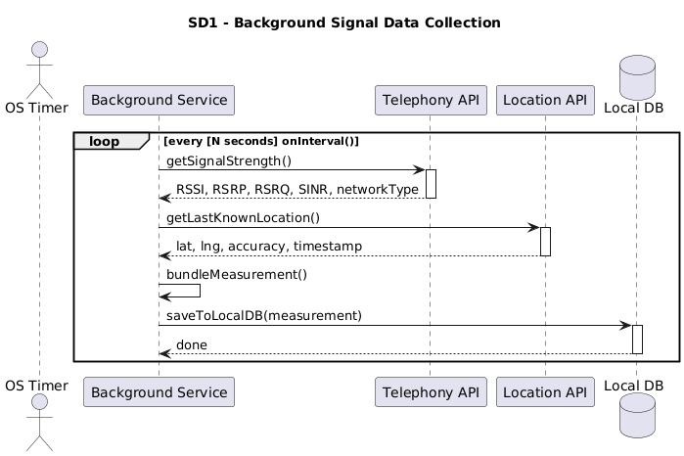
SD1 — Background Signal Data Collection
How it works
1. OS Timer fires every N seconds 2. Background Service calls Telephony API → gets RSSI, RSRP, RSRQ, SINR, network type 3. Location API called → returns lat, lng, accuracy, timestamp 4. Measurement bundled into a single object 5. Saved to Local DB silently (no user interaction needed)
9
9

Slide 10
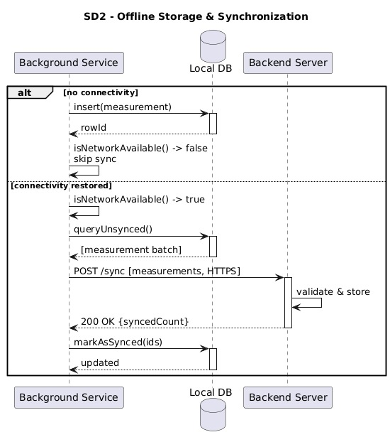
SD2 — Offline Storage & Synchronization
Two Scenarios
No Connectivity
• insert(measurement) → Local DB
• rowId returned
• isNetworkAvailable() = false
• sync skipped
Connectivity Restored
• queryUnsynced() → batch collected
• POST /sync [measurements, HTTPS]
• Server validates & stores
• 200 OK {syncedCount} returned
• markAsSynced(ids) → no re-upload
10
10

Slide 11
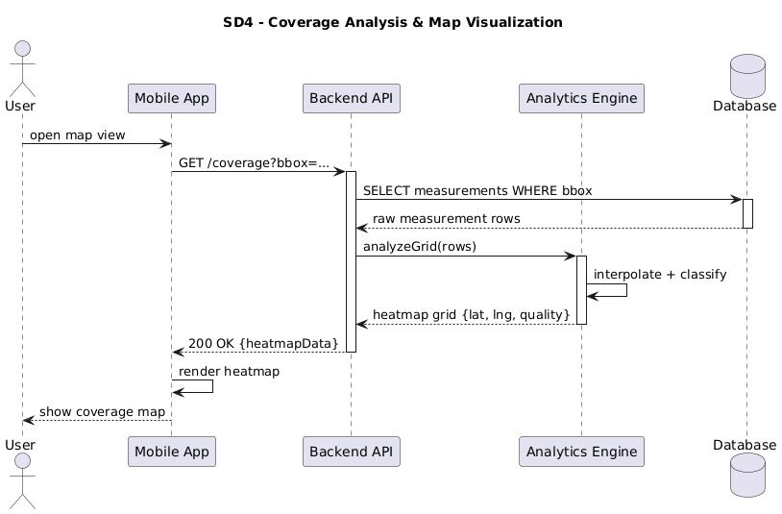
SD4 — Coverage Analysis & Map Visualization
Flow Summary
User opens map view in app
GET /coverage?bbox=... sent to Backend API
Backend SELECTs measurements within bounding box
Analytics Engine interpolates & classifies signal quality
Heatmap grid {lat, lng, quality} returned
App renders colored heatmap overlay
(Red = poor, Green = good signal)
11
11

Slide 12
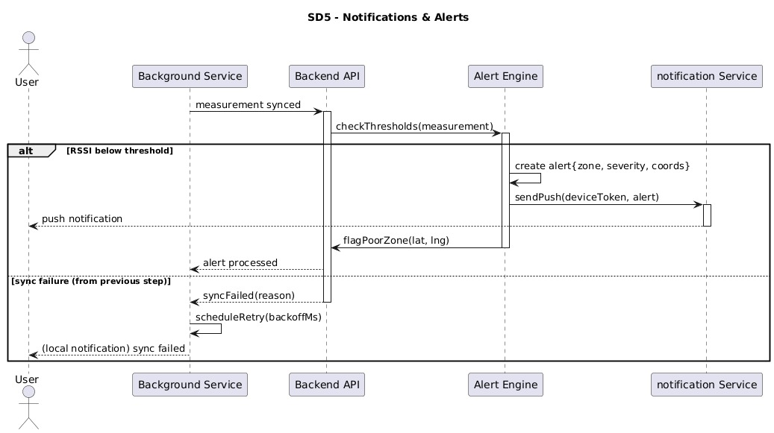
SD5 — Notifications & Alerts
Alert Logic
Threshold Check
After sync, Alert Engine checks RSSI against defined thresholds
Alert Creation
If RSSI below threshold → creates alert {zone, severity, coords}
Push Notification
Push Service (e.g., FCM) sends notification to user device
Poor Zone Flagging
Backend flags geographic zone as poor coverage
Sync Failure Retry
On failure: scheduleRetry(backoffMs) with exponential backoff
User Notification
Local notification informs user of sync failure
12
12

Slide 13
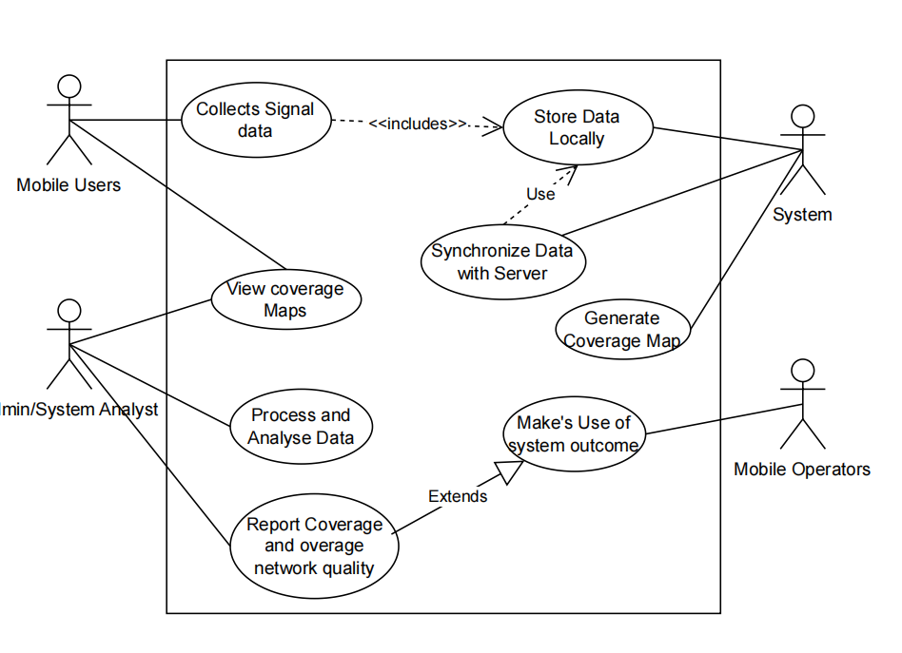
Use Case Diagram
Actors
Mobile User
Collects signal data, views coverage maps, syncs data
Admin/Analyst
Processes & analyzes data, generates coverage reports
System
Stores data locally, generates coverage map
Mobile Operators
Makes use of system outcome
Core Use Cases
Collect Signal Data (RSSI, RSRP, RSRQ, GPS)
Store Data Locally <<include>>
Synchronize Data with Server
View Coverage Maps & Reports
Process & Analyze Data
13
13

Slide 14
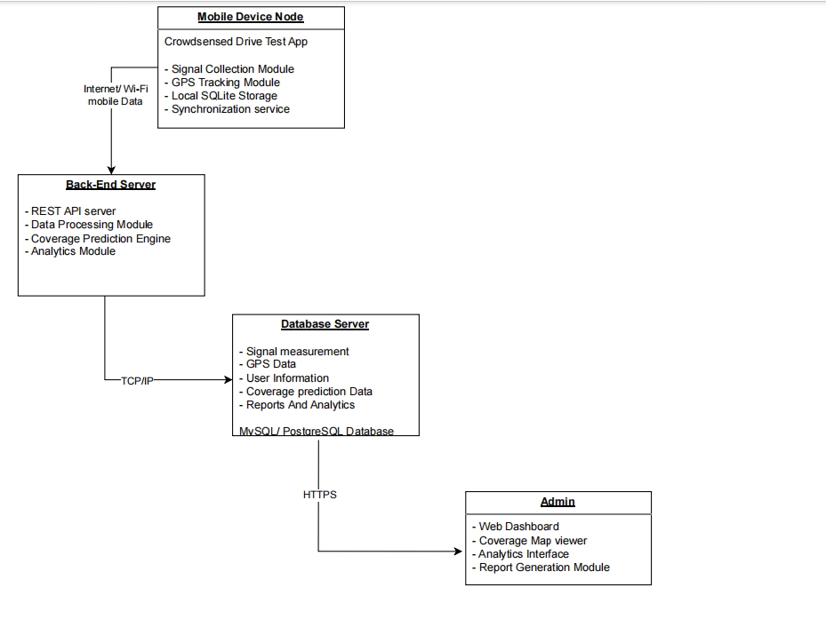
Deployment Diagram
Deployment Nodes
Mobile Device Node
Crowdsensed Drive Test App
Signal Collection, GPS Tracking, Local SQLite, Sync Service
Connects via Internet/Wi-Fi
Back-End Server Node
REST API, Data Processing Module
Coverage Prediction Engine, Analytics Module
Receives data, performs analysis
Database Server Node
MySQL/PostgreSQL
Stores: Signal Measurements, GPS Data, User Info, Predictions, Reports
Connects via TCP/IP
Admin Node
Web Dashboard, Coverage Map Viewer
Analytics Interface, Report Generation
Access via HTTPS
14
14

Slide 15
Importance & Conclusion
Why It Matters
Conclusion
Provides a clear blueprint for implementation
Improves understanding of the system architecture
Simplifies communication between developers and stakeholders
Supports maintenance and future upgrades
Helps identify system requirements early
Reduces implementation errors and complexity
The system modelling and design phase provided a complete representation of the Crowdsensed Drive Test Mobile Application for Coverage Prediction before implementation.
Together, the six diagrams created a strong foundation:
Context Diagram — System boundaries
Data Flow Diagram — Data movement
Use Case Diagram — User interactions
Sequence Diagram — Component interactions
Class Diagram — Object-oriented structure
Deployment Diagram — Physical architecture
15

